Slide 1
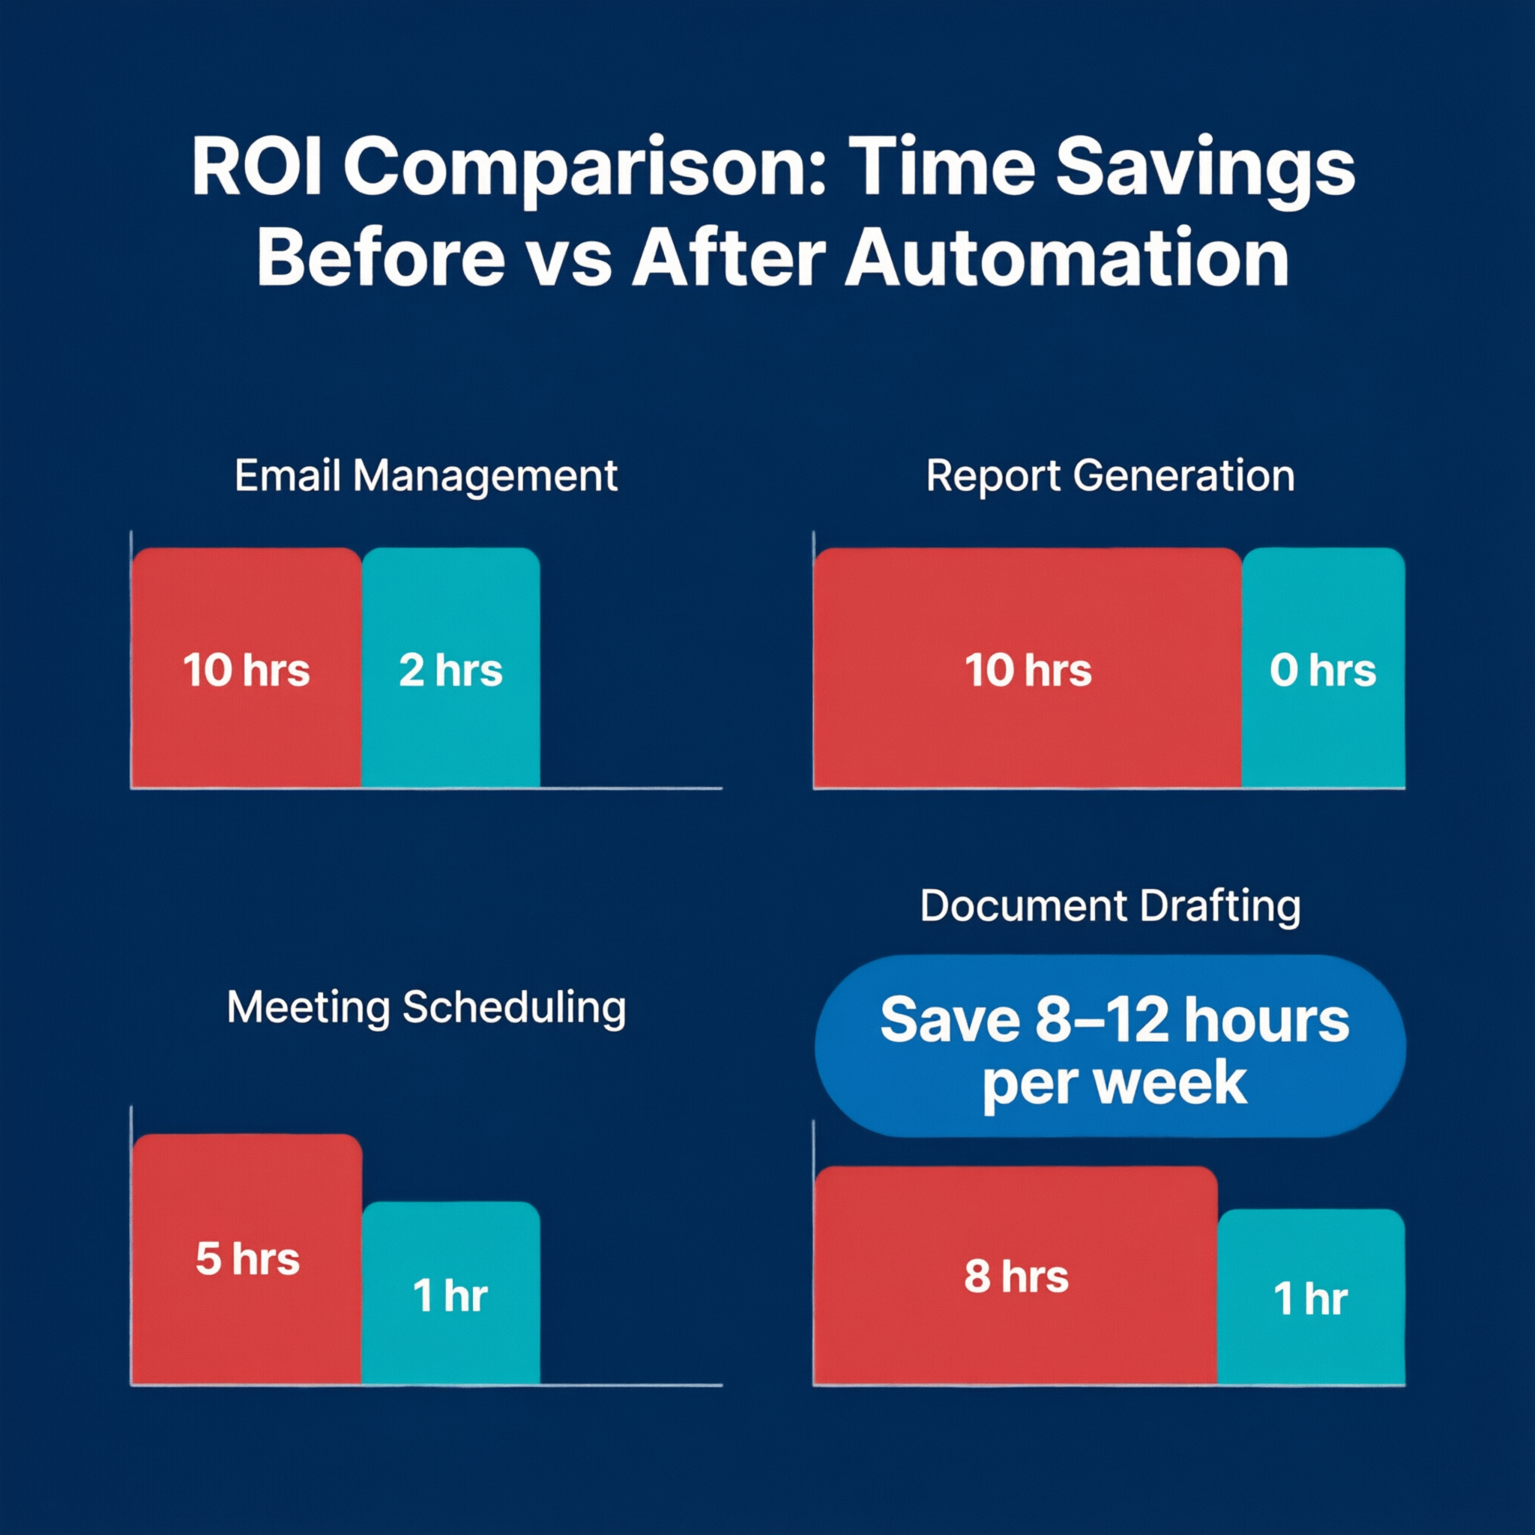
Let's Build! 🛠️
OpenClaw for Office Managers — Day 2: Hands-On Labs
6 Hours · 4 Labs · 1 Capstone · Zero to Automated
Notes:
Welcome back to Day 2! Today is all about hands-on building. You'll go from zero to having real automations running by the end of the day.

Slide 2
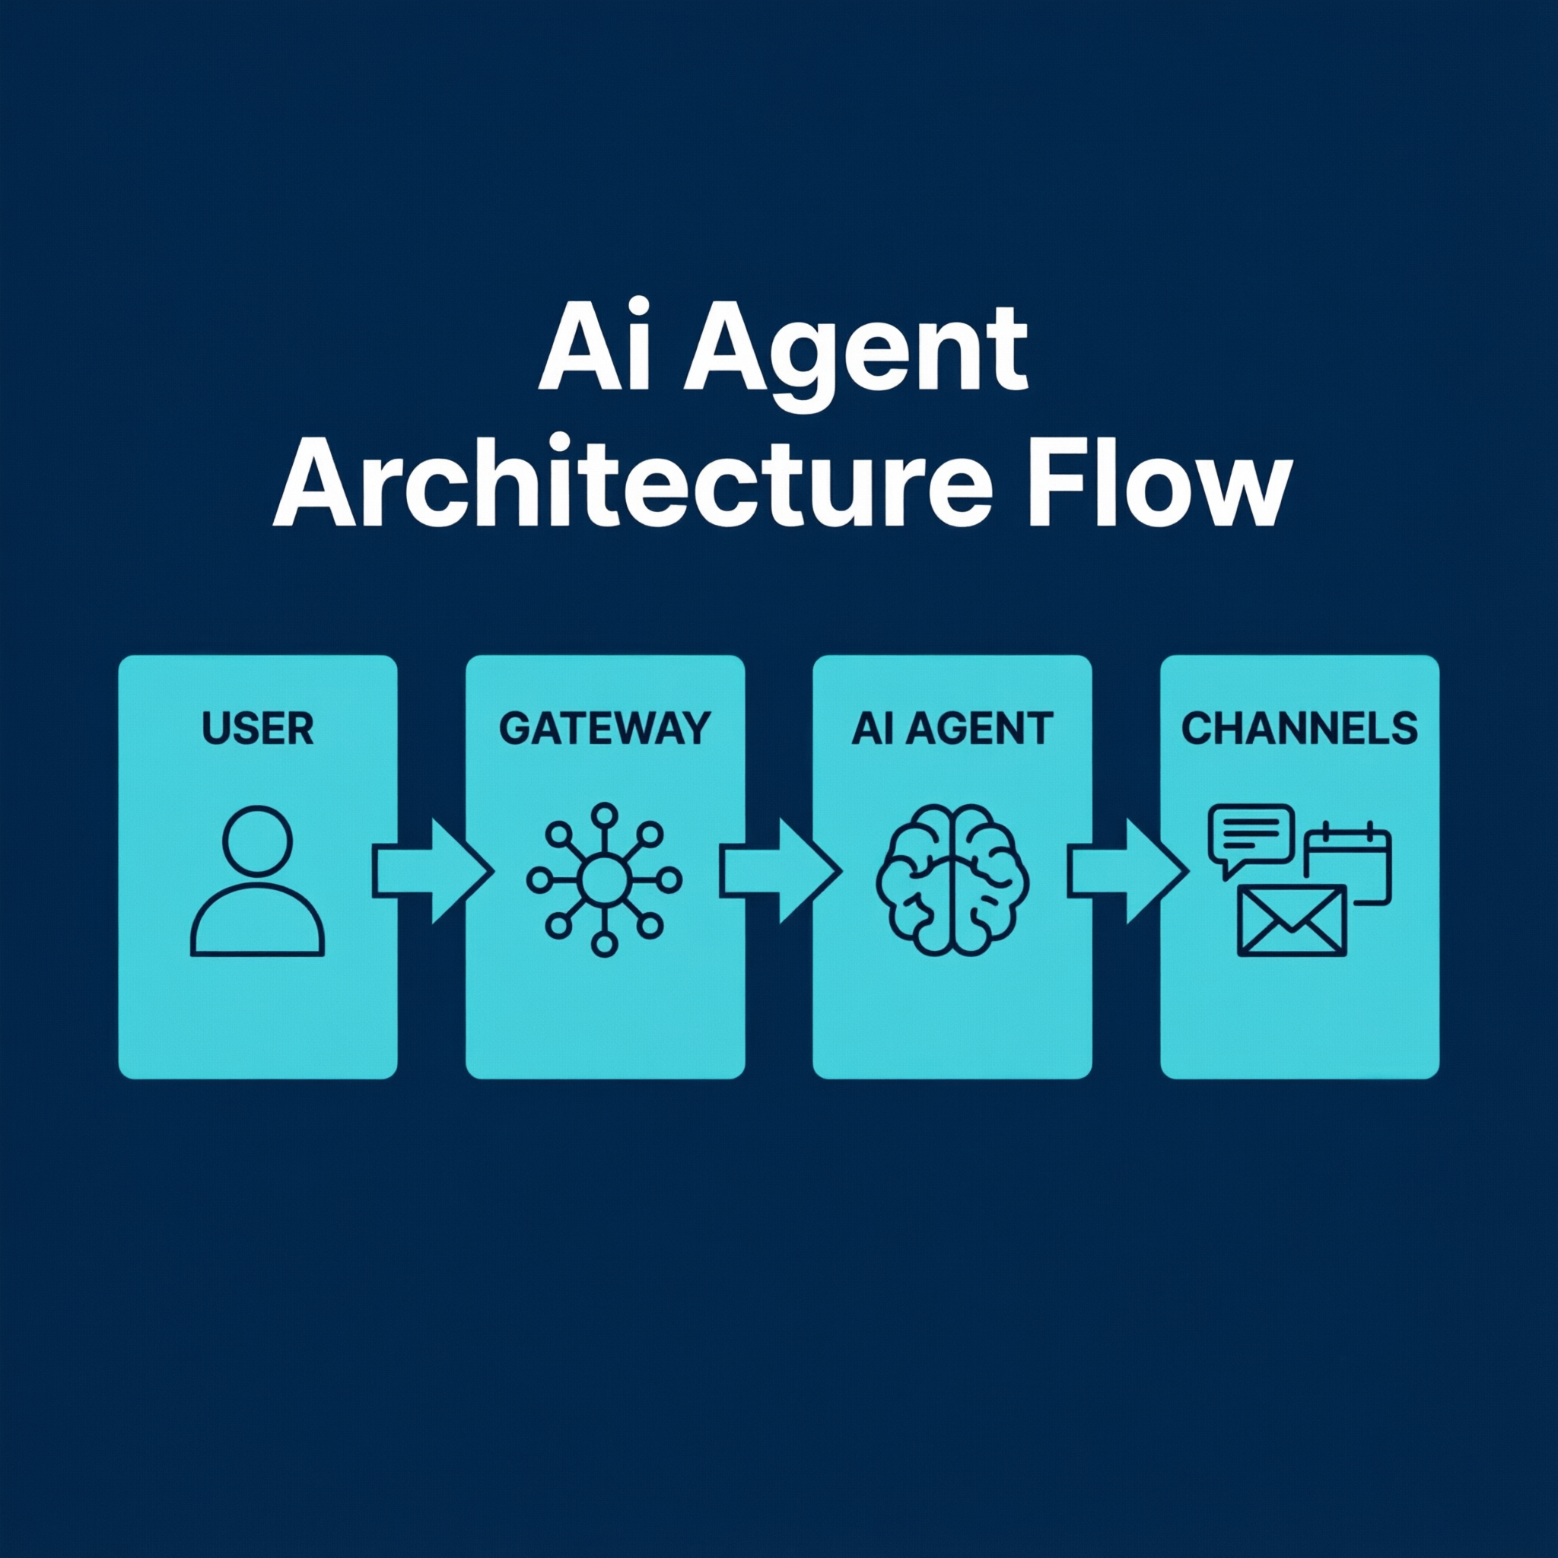
Today's Roadmap
0:00–0:30 Lab 0: Setup Check
0:30–1:30 Lab 1: Connect a Channel (Slack/Teams)
1:30–2:45 Lab 2: Cron-Based Report Generator
2:45–3:00 ☕ Break
3:00–4:00 Lab 3: Email Triage Skill
4:00–4:15 ☕ Break
4:15–5:15 Lab 4: Webhook-Driven Document Workflow
5:15–6:00 Capstone Project & Showcase
2 / 15
Notes:
Here's the full schedule. We have two breaks built in. Each lab builds on the previous one. If you fall behind, the capstone is a chance to catch up and build something meaningful to you.

Slide 3
Lab 0: Setup Checklist ✅
1. Run: openclaw --version (should show version number)
2. Run: openclaw onboard (if not done yet)
3. Test: openclaw message send 'Hello from my first session'
4. Check: ~/.openclaw/workspace/ directory exists
5. Verify: OpenAI or Anthropic API key is configured
Need help? Raise your hand — we'll get everyone set up.
3 / 15
Notes:
Walk around the room and help everyone get set up. This is the most critical step — if setup fails, nothing else works. Have a troubleshooting checklist ready: Node.js version, npm global path, API key validity.

Slide 4
Lab 1: Connect a Channel
Goal: Connect OpenClaw to Slack or Teams and send your first automated message
Time: 60 minutes
You'll learn: Channel configuration, bot tokens, gateway restart
Deliverable: Bot responds when you message it in Slack/Teams
4 / 15
Notes:
Lab 1 is about connecting a channel. This is your first 'aha!' moment — when the bot responds in Slack for the first time. Walk through the steps, then circulate and help.

Slide 5
Lab 1: Step-by-Step
Step 1: Create a Slack App at api.slack.com → Get Bot Token
Step 2: Open ~/.openclaw/workspace/gateway.yaml
Step 3: Add Slack config under 'channels' section
Step 4: Run: openclaw gateway restart
Step 5: Send a message to your bot in Slack
Step 6: Verify the bot responds!
channels:
slack:
enabled: true
bot_token: "xoxb-your-token-here"
5 / 15
Notes:
Go through each step. The Slack app creation is the trickiest part — make sure people add the right scopes (chat:write, channels:history, app_mentions:read). Invite the bot to a channel before testing.

Slide 6
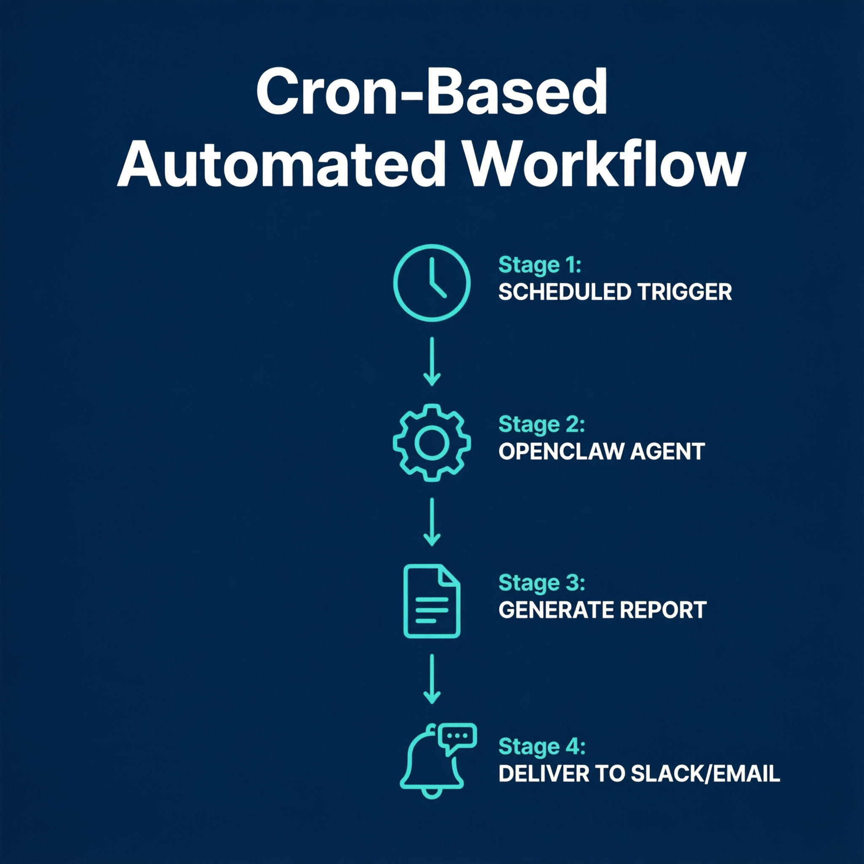
Lab 2: Cron-Based Report Generator
Goal: Create a scheduled task that compiles data and sends a summary daily
Time: 75 minutes
You'll learn: Cron syntax, skill creation, scheduled triggers
Deliverable: Automated daily report arrives in Slack every morning
6 / 15
Notes:
Lab 2 is the cron-based report. This is probably the most impactful automation for office managers — replacing manual daily report compilation. You'll create a skill and schedule it with cron.

Slide 7
Lab 2: Step-by-Step
Step 1: Create directory: ~/.openclaw/workspace/skills/daily-report/
Step 2: Write SKILL.md with report generation instructions
Step 3: Add cron entry in gateway.yaml
Step 4: Test immediately: openclaw cron run 'Daily Report'
Step 5: Verify output in Slack
cron:
- name: "Daily Report"
schedule: "0 9 * * 1-5" # 9 AM, Mon-Fri
agent: "main"
message: "Generate the daily sales summary report"
7 / 15
Notes:
The SKILL.md should instruct the AI to read from a sample CSV file, identify key metrics, and format a clean summary. Test with manual cron run first, then set the schedule.

Slide 8
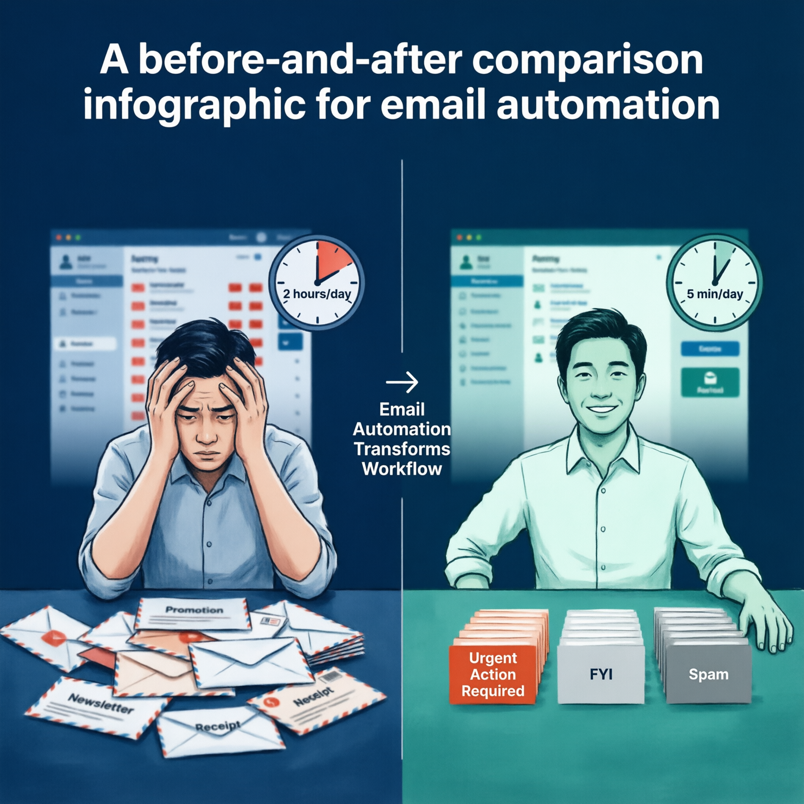
Lab 3: Email Triage Skill
Goal: Build a custom skill that categorizes and auto-responds to emails
Time: 60 minutes
You'll learn: Custom skill writing, classification logic, draft responses
Deliverable: Working email triage with your own categories
8 / 15
Notes:
Lab 3 is about writing your own skill. The SKILL.md file is just text — describe how you want emails classified and what actions to take. This is where the real customization happens.

Slide 9
Lab 3: Step-by-Step
Step 1: Create: ~/.openclaw/workspace/skills/email-triage/SKILL.md
Step 2: Define your categories (Urgent, Action, FYI, Spam)
Step 3: Write classification rules in plain English
Step 4: Add draft response template for each category
Step 5: Test with 5 sample emails
Step 6: Customize categories for YOUR workflow
9 / 15
Notes:
Emphasize that the categories should be CUSTOM to each person's role. An HR manager's 'Urgent' is different from a finance manager's 'Urgent'. Have people think about their own workflow.

Slide 10
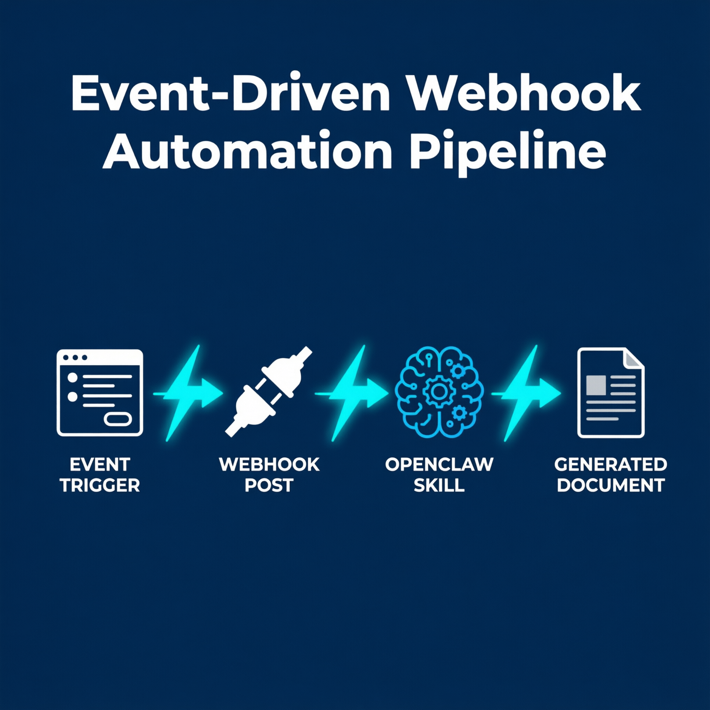
Lab 4: Webhook-Driven Document Workflow
Goal: Trigger document generation from a webhook (form submission → auto-report)
Time: 60 minutes
You'll learn: Webhook configuration, event-driven triggers, document generation
Deliverable: Webhook-triggered report generation
10 / 15
Notes:
Lab 4 is the most advanced — webhook-driven document generation. This connects external events (form submissions, API calls) to OpenClaw automations. Very powerful for workflows that start outside of Slack.

Slide 11
Lab 4: Step-by-Step
Step 1: Enable webhooks in gateway.yaml
Step 2: Create a skill that responds to /report-request
Step 3: Test with curl command
Step 4: Verify generated report output
Step 5: Optional — connect to Google Forms or Typeform
curl -X POST http://localhost:3000/report-request \
-H "Content-Type: application/json" \
-d '{"topic": "Q1 Sales", "date": "2026-03-31"}'
11 / 15
Notes:
The curl command is the test trigger. If people aren't comfortable with terminal, show them how to use a tool like Postman or a browser extension. The key concept is: external event → webhook → OpenClaw skill → document output.

Slide 12
🏆 Capstone: Build Your Own Automation
Pick ONE real task from your daily work and automate it
1. Identify: What task wastes your time?
2. Design: Trigger → Action → Output
3. Build: Use patterns from Labs 1-4
4. Share: 2-minute demo to the group
Time: 45 minutes build + 15 minutes showcase
12 / 15
Notes:
Capstone time! This is where it all comes together. Give people 45 minutes to build, then 2 minutes each to present. The presentation should cover: what it does, how much time it saves, and what they'd improve next.

Slide 13
Troubleshooting Tips 🔧
Gateway not starting? → Check: openclaw gateway status
Slack bot not responding? → Verify bot is invited to the channel
Cron not firing? → Check timezone in gateway.yaml
Webhook 404? → Confirm path matches in config and curl
Skill not loading? → File must be named SKILL.md exactly
API errors? → Verify your key has sufficient quota/credits
13 / 15
Notes:
Keep this slide up during the labs. These are the most common issues. Walk around proactively — don't wait for people to raise their hand.

Slide 14
Resources & Next Steps 📚
📖 Documentation: github.com/openclaw/openclaw
🦞 ClawHub Registry: 5,400+ community skills to install
💬 Community: Discord server for support and ideas
📧 Newsletter: Stay updated on new features
🔧 Next: Connect more channels, chain multiple skills, add voice
This is just the beginning. Automate one new task every week.
14 / 15
Notes:
Point people to the documentation and community. Encourage them to start small — automate one new task each week. The ClawHub registry is a great place to find pre-built skills they can customize.

Slide 15
Thank You! 🙏
Now go automate something!
Scan the QR code to share your feedback
[ QR Code Placeholder ]
15 / 15
Notes:
Thank everyone for their participation. Remind them to scan the feedback QR code. Offer to stay for 15 minutes for anyone who needs extra help. Collect feedback forms before dismissing.

