Slide 1

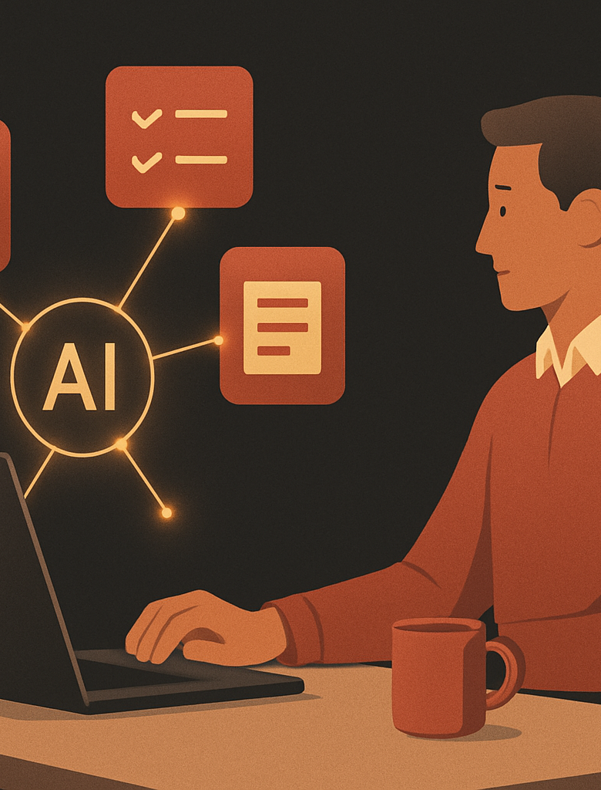

AI Automation Series. Session 1
Build Office Automation With Hermes
Create four practical tools, then connect them into your personal task tracker.
DAY 2. HANDS ON BUILDS
Hands on
4 builds
Cron
Capstone
AI Automation Series · © 2026 PakEdX
01 / 22

Slide 2
ROADMAP
Today At A Glance
Build 1
Email Triage sorts mail and drafts routine replies.
Build 2
Morning Brief runs every weekday at 08:00 PKT.
Build 3
Meeting Actions turns rough notes into clear tasks.
Capstone
My Day combines the outputs into one task list.
AI Automation Series · © 2026 PakEdX
02 / 22

Slide 3
01
LAB SETUP
Build Safely
AI Automation Series · © 2026 PakEdX
03 / 22

Slide 4
LAB 0
Lab 0: Setup Check
1. Open Hermes Desktop or the class web chat.
2. Confirm your model is connected and replies.
3. Connect email only when the trainer is present.
4. Confirm calendar access for the Morning Brief.
5. Keep approval on for any message that can be sent.
Use a test inbox if you do not want to connect real email today.
AI Automation Series · © 2026 PakEdX
04 / 22

Slide 5
The Build Rhythm
Watch demo
First see the finished tool run once.
Build together
Follow the trainer step by step at the same pace.
Tune your own
Change categories, tone, sources, and timing.
Share output
Show one useful result and one thing you improved.
AI Automation Series · © 2026 PakEdX
05 / 22

Slide 6
02
BUILD 1
Email Triage Agent
AI Automation Series · © 2026 PakEdX
06 / 22

Slide 7
EMAIL TRIAGE
Build 1 Goal
Input
New emails from your inbox or a test account.
Work
Read, sort, summarise, and draft routine replies.
Output
A scan friendly list with drafts for approval.
Safety
Nothing is sent until you approve it.
AI Automation Series · © 2026 PakEdX
07 / 22

Slide 8
HOW IT WORKS
Email Triage Agent Flow
New Emails
Read And Sort
Draft Reply
Approve
Send Or File
Client mail, updates, newsletters, and spam arrive.
Hermes groups each message by action needed.
Routine replies are prepared in your voice.
You edit, reject, or approve each draft.
Only approved work leaves your inbox.
Safety rule: Hermes can draft. It must not send without approval.
AI Automation Series · © 2026 PakEdX
08 / 22

Slide 9
Build 1 Step Map
Connect email
Add the email channel and approve the minimum access needed.
Create skill
Name it Email Triage and paste the starter instructions.
Run test
Ask Hermes to triage the latest messages.
Refine rules
Fix categories, tone, newsletter handling, and deadlines.
AI Automation Series · © 2026 PakEdX
09 / 22

Slide 10
COPY AND EDIT
Email Triage Starter
Skill: Email Triage
When new emails arrive, read each one.
Sort into Needs Reply, FYI, or Ignore.
For routine Needs Reply email, write a short polite draft.
Never send anything. Show each draft for approval.
Summarise each email in one line so I can scan quickly.
Add your name, role, and preferred reply tone before testing.
AI Automation Series · © 2026 PakEdX
10 / 22

Slide 11
Tuning The Triage Agent
Categories
Add labels that match your real work, such as Clients or Invoices.
Tone
Say warm, brief, formal, or friendly so drafts sound right.
Newsletters
Treat unsubscribe mail as FYI or Ignore.
Deadlines
Flag anything with a due date as urgent.
AI Automation Series · © 2026 PakEdX
11 / 22

Slide 12
03
BUILD 2
Morning Brief Bot
AI Automation Series · © 2026 PakEdX
12 / 22

Slide 13
MORNING BRIEF
Build 2 Goal
Inbox
Summarise important new emails since yesterday.
Calendar
Show today's meetings with times.
Top 3
Pick the three items that need focus.
Delivery
Send the brief to web chat, email, or phone.
AI Automation Series · © 2026 PakEdX
13 / 22

Slide 14
HOW IT WORKS
Morning Brief And Cron
Cron Schedule
Morning Brief
Delivery Channel
08:00
Runs on weekdays, even when you are not watching.
Reads inbox, calendar, and the focus rules you set.
Sends the short brief to web chat, email, or phone.
PKT
Always test a schedule two minutes from now, then set it back to 08:00 PKT.
AI Automation Series · © 2026 PakEdX
14 / 22

Slide 15
COPY AND EDIT
Morning Brief Starter
Skill: Morning Brief
Each morning, give me a short brief with three parts.
Inbox: important new emails since yesterday, grouped by urgency.
Calendar: today's meetings with times.
Top 3: the three things I should focus on today.
Keep it under 200 words. Do not send emails or make changes.
Schedule it for weekdays at 08:00 PKT after the manual test works.
AI Automation Series · © 2026 PakEdX
15 / 22

Slide 16
Test The Schedule
Run now
Trigger the brief by chat and check the content.
Fire soon
Set the schedule two minutes from now for a real test.
Set daily
Change it back to weekdays at 08:00 PKT.
Pick channel
Choose where the brief should arrive every morning.
AI Automation Series · © 2026 PakEdX
16 / 22

Slide 17
04
BUILD 3
Meeting Actions
AI Automation Series · © 2026 PakEdX
17 / 22

Slide 18
BUILD 3
Meeting Notes To Actions
Paste messy notes
Use real notes, rough bullets, or a typed voice note.
Extract actions
Return the task, owner, and deadline for each item.
Do not invent
Write unassigned or no date when details are missing.
Make it shareable
Format the list so you can send it to the team.
AI Automation Series · © 2026 PakEdX
18 / 22

Slide 19
COPY AND EDIT
Meeting Actions Starter
Skill: Meeting Actions
I will paste rough meeting notes.
Produce a clean action list.
For each action, show task, owner, and deadline.
If owner or deadline is missing, write unassigned or no date.
List open questions and decisions that are still unresolved.
Ask Hermes to split combined tasks if the notes are crowded.
AI Automation Series · © 2026 PakEdX
19 / 22

Slide 20
05
CAPSTONE
My Day Tracker
AI Automation Series · © 2026 PakEdX
20 / 22

Slide 21
PERSONAL TASK SYSTEM
Capstone: My Day Tracker
Email Triage
Replies and urgent messages.
My Day
Daily Channel
Morning Brief
One top 10 list, ordered by priority.
Web chat, email, or phone at 08:15 PKT.
Meetings and top focus areas.
Meeting Actions
Tasks with owners and dates.
The capstone connects the builds into one practical morning habit.
AI Automation Series · © 2026 PakEdX
21 / 22

Slide 22
MAINTENANCE
Keep It Running After Class
Weekly check
Confirm the brief arrived and the schedules are still on.
Refresh skills
Update instructions when your work changes.
Reconnect channels
Re approve email or calendar if a connection expires.
Keep approval
Leave human review on for anything sent in your name.
AI Automation Series · © 2026 PakEdX
22 / 22

