Slide 1
Automate Your Office with AI
OpenClaw for Office Managers — Day 1: Theory & Concepts
🦞 Open Source · Local-First · No-Code Friendly
Notes:
Welcome everyone! Today is Day 1 — we'll cover the theory behind office automation and introduce OpenClaw as a tool you can use starting tomorrow's hands-on session. By the end of today, you'll understand what's possible and be ready to build.

Slide 2
Today's Agenda
Module 1: What is Office Automation? (30 min)
Module 2: Introduction to OpenClaw (30 min)
☕ Break (15 min)
Module 3: Core Capabilities — Live Demo (45 min)
Module 4: Skills & Automation Patterns (30 min)
Q&A + Lab Prep (15 min)
2 / 20
Notes:
Here's our roadmap for the day. We'll balance concepts with live demos. Please hold questions until Q&A or the breaks.

Slide 3
🤔 What repetitive task wastes your time every week?
Turn to someone next to you — share your #1 time-waster
"I spend 2 hours every Monday compiling reports"
"I manually forward the same emails to different people"
"I keep drafting the same type of document from scratch"
3 / 20
Notes:
Icebreaker: Have people pair up and share their biggest time-wasting task. After 2 minutes, ask 2-3 volunteers to share with the group. These real examples will be referenced throughout the training.

Slide 4
What is Office Automation?
The use of technology to perform repetitive office tasks without manual effort
Evolution: Macros (Excel) → RPA (UiPath) → Scripts (Python) → AI Agents (OpenClaw)
The key shift: AI agents understand natural language instructions — no code needed
Today's office manager doesn't need to be a programmer to automate.
4 / 20
Notes:
Walk through the evolution. Emphasize that AI agents are the biggest leap because they accept plain-English instructions. Office managers can describe what they want without writing code.

Slide 5
Why AI Agents Change Everything
No-code: Describe what you want in plain language
Multi-app: Connect Slack, email, calendar, files in one workflow
Adaptive: Learns from corrections and improves over time
Always-on: Runs 24/7 on your own machine — no monthly SaaS fees
Compare: Old RPA took weeks to set up. OpenClaw takes minutes.
5 / 20
Notes:
Emphasize the contrast with traditional RPA tools that require developers and weeks of setup. OpenClaw's agent model means you describe the task and the AI figures out the steps.

Slide 6
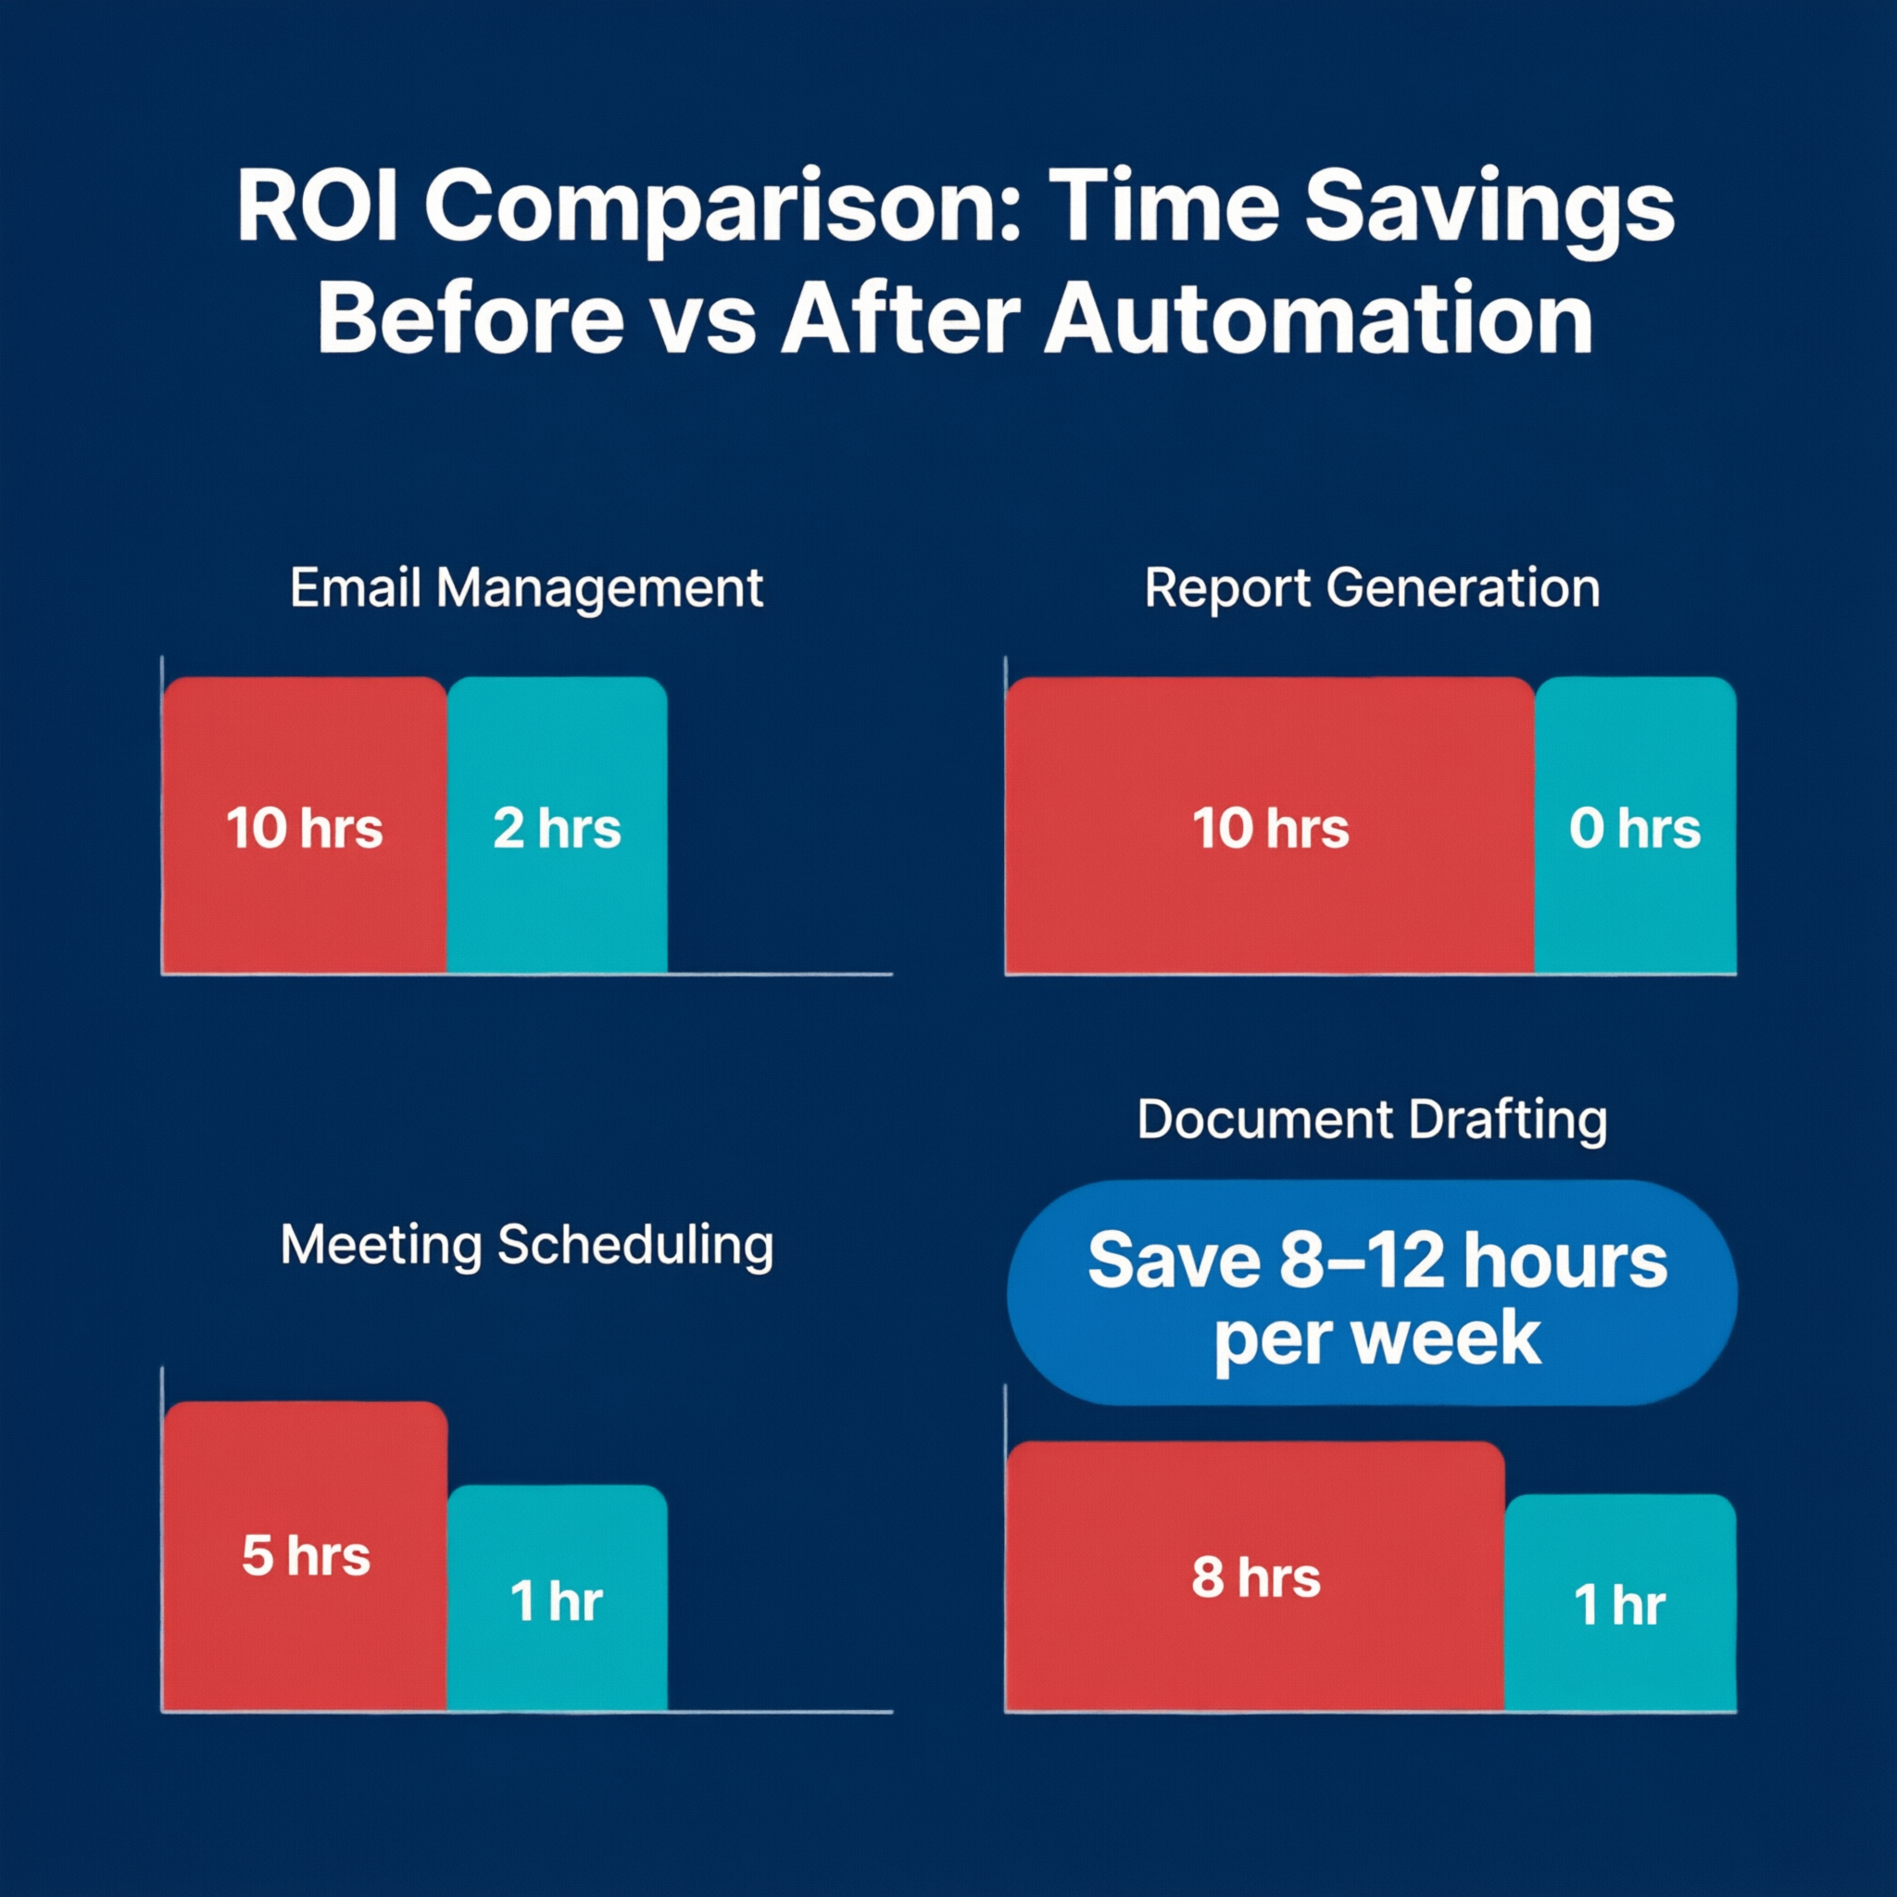
Real ROI Examples
📧 Email triage → Save 5 hrs/week on sorting and responding
📊 Report generation → 2 hrs/day reduced to 0 (fully automated)
📅 Meeting scheduling → Eliminate 30+ back-and-forth emails per week
📄 Document drafting → First draft ready in 60 seconds vs. 30 minutes
Conservative estimate: 8-12 hours saved per week per person
6 / 20
Notes:
These are conservative estimates based on early adopters. The actual ROI depends on how many repetitive tasks each person handles. In tomorrow's session, each of you will calculate your own time savings.

Slide 7
Meet OpenClaw 🦞
Your own personal AI assistant — Any OS, Any Platform
Open-source (GitHub: openclaw/openclaw)
Local-first — runs on your machine, your data stays yours
Multi-channel: Slack, Teams, WhatsApp, Gmail, Telegram, Discord & more
Built-in automation: Cron jobs, webhooks, skills system
Node.js runtime — install with one command: npm install -g openclaw
7 / 20
Notes:
OpenClaw is an open-source project — it's free, it's transparent, and the community is actively building on it. The lobster emoji is their mascot. Key point: it runs locally, which means no data leaves your machine unless you configure it to.

Slide 8
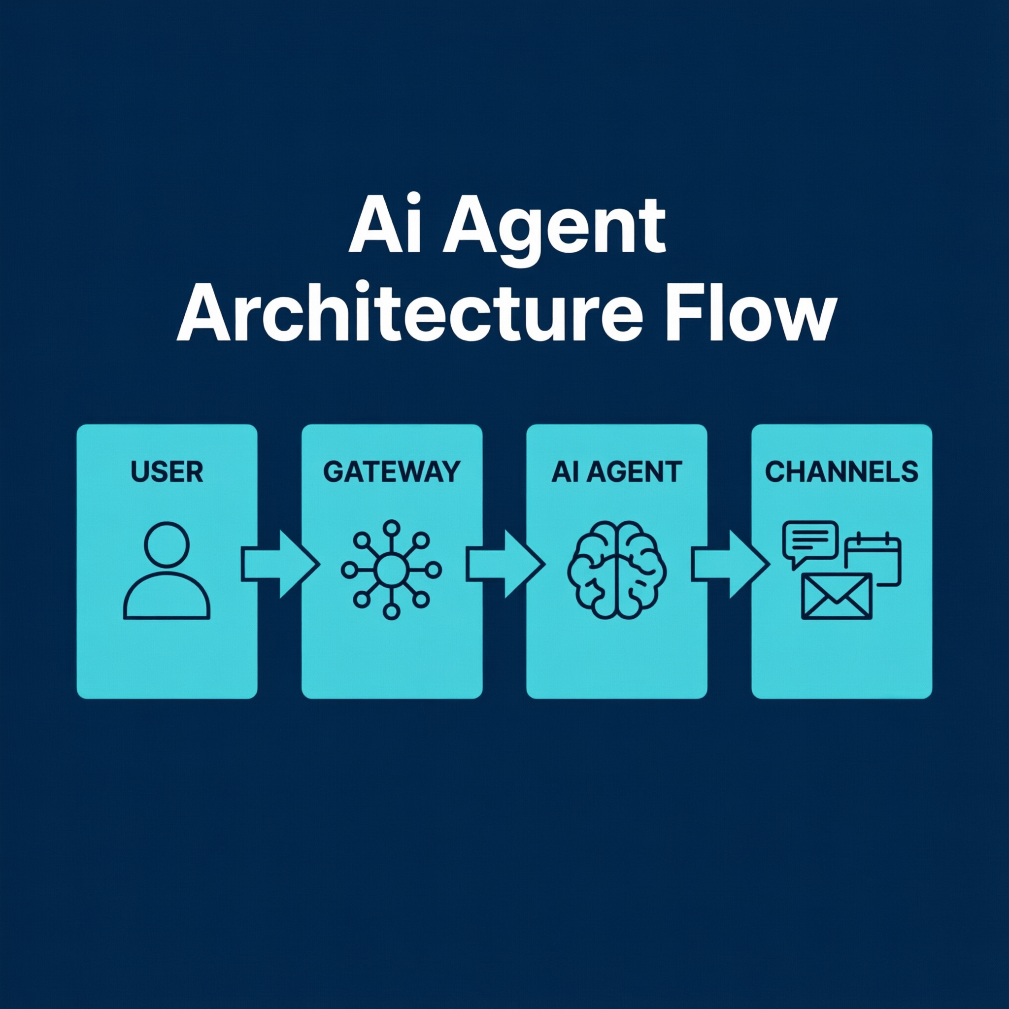
How OpenClaw Works
YOU
GATEWAY
CHANNELS
→
→
Gateway routes your message to an AI agent →
Agent reads your SKILL.md instructions →
Agent executes tools (browser, files, cron, webhooks) →
Response sent back to your channel (Slack, Teams, etc.)
Workspace: ~/.openclaw/workspace/ — where all your config and skills live
8 / 20
Notes:
Walk through the architecture: You send a message → Gateway receives it → Routes to an AI agent → Agent follows your skill instructions → Executes actions → Sends response back. The workspace directory is where everything is configured. Tomorrow you'll work directly in this directory.

Slide 9
Why Local-First Matters
🔒 Your data never leaves your machine unless you configure it to
💰 No per-user monthly SaaS fees — runs on hardware you own
🔧 Full control — modify, extend, or disable any feature
📡 Works offline — no cloud dependency for local automations
🏢 IT-friendly — can be deployed on-premise behind firewalls
9 / 20
Notes:
This is a key differentiator. Many AI tools send your data to the cloud. OpenClaw runs locally — important for organizations with data compliance requirements. IT departments appreciate that it can run behind firewalls.

Slide 10
Channels: Where It Connects
💬 Slack
💬 Microsoft Teams
💬 Discord
💬 WhatsApp
💬 Telegram
💬 Signal
📧 Gmail
💬 Google Chat
💬 iMessage
💬 IRC
🌐 WebChat (built-in)
💬 + 15 more...
Tomorrow: We'll connect OpenClaw to Slack or Teams in Lab 1
10 / 20
Notes:
OpenClaw supports 20+ channels. Most offices use Slack or Teams — we'll focus on those in the labs. But the same principles apply to any channel. You can even connect multiple channels simultaneously.

Slide 11
Skills: The Building Blocks
A Skill = a Markdown file (SKILL.md) that tells the AI what to do
Stored in: ~/.openclaw/workspace/skills/<skill-name>/SKILL.md
5,400+ community skills available on ClawHub registry
You can write your own — just describe the behavior in plain English
Skills can include: triggers, instructions, tool access, output format
# SKILL.md Example
# Email Triage — classify and summarize incoming emails
When you receive an email:
1. Classify as: Urgent / Action Required / FYI / Spam
2. Write a one-line summary
3. Draft a suggested response (if Action Required)
11 / 20
Notes:
Skills are the core concept. A skill is just a text file with instructions. You write what you want the AI to do in plain English. The ClawHub registry has thousands of pre-built skills you can install. But writing your own is just as easy.

Slide 12
Cron Jobs: Automate on Schedule
Run any automation at a specific time — daily, weekly, monthly
Uses standard cron syntax: minute hour day month weekday
Perfect for: daily reports, weekly digests, monthly summaries
# Example: Daily report at 9 AM, Monday-Friday
cron:
- name: "Daily Sales Report"
schedule: "0 9 * * 1-5" # 9 AM, Mon-Fri
agent: "main"
message: "Generate the daily sales summary report"
# Example: Weekly digest every Friday at 5 PM
schedule: "0 17 * * 5" # 5 PM, Friday
12 / 20
Notes:
Cron is a Unix concept for scheduled tasks. The syntax is: minute hour day month weekday. Asterisks mean 'every'. So '0 9 * * 1-5' means: at minute 0, hour 9, every day, every month, Monday through Friday. In Lab 2, you'll set up your own cron job.

Slide 13
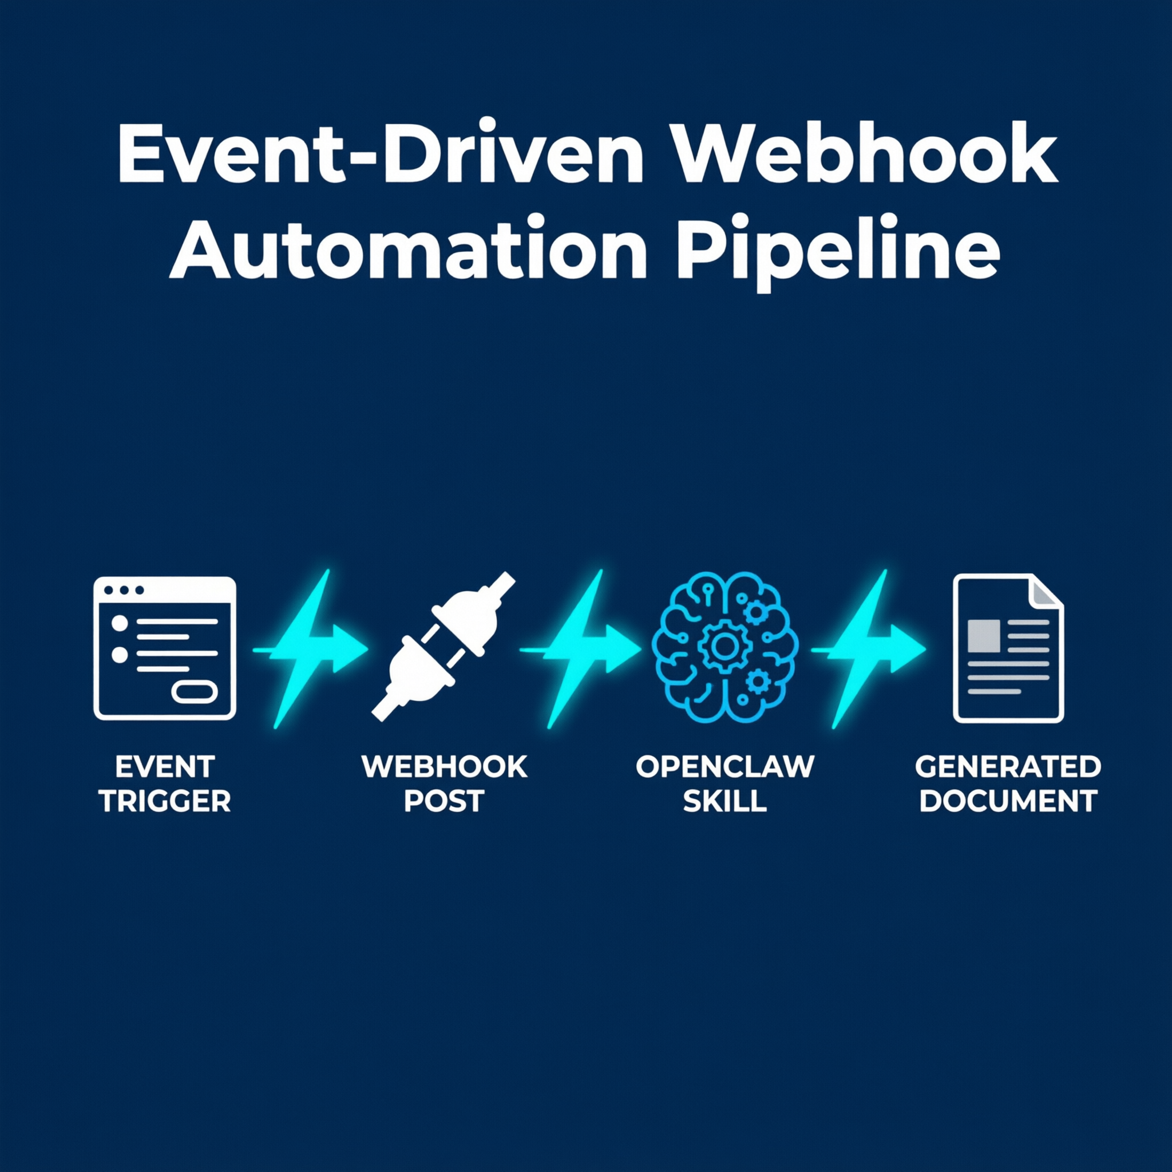
Webhooks: Automate on Event
Trigger an automation when something happens externally
Examples: Form submitted → Generate report, Email received → Triage it
Any app that sends a POST request can trigger a webhook
# Enable webhook in gateway.yaml
webhooks:
- name: "Report Request"
path: "/report-request"
# Trigger it from anywhere:
curl -X POST http://localhost:3000/report-request \
-H "Content-Type: application/json" \
-d '{"topic": "Q1 Sales", "date": "2026-03-31"}'
13 / 20
Notes:
Webhooks are event-driven triggers. Instead of running on a schedule, they run when something happens — a form is submitted, an email arrives, a file is uploaded. In Lab 4, you'll build a webhook-triggered document generation workflow.

Slide 14
🔴 Live Demo: OpenClaw + Slack
What we'll do right now:
1. Create a Slack app and get a bot token
2. Configure OpenClaw's gateway.yaml with the token
3. Restart the gateway
4. Send a message to the bot in Slack
5. Watch it respond in real-time
14 / 20
Notes:
LIVE DEMO: Switch to your terminal. Walk through the 5 steps. If Slack setup fails, have a pre-recorded backup. Make sure the Slack app is pre-created with bot scopes: chat:write, channels:history.

Slide 15
🔴 Live Demo: Daily Report via Cron
What we'll do right now:
1. Create a 'daily-report' skill with a prompt
2. Add a cron entry in gateway.yaml
3. Test it immediately with: openclaw cron run 'Daily Report'
4. Watch the report arrive in Slack
15 / 20
Notes:
LIVE DEMO: Show the skill creation, cron config, and manual trigger. Have a sample CSV ready as the data source. The cron syntax should match a time that's soon so participants see it fire naturally.

Slide 16
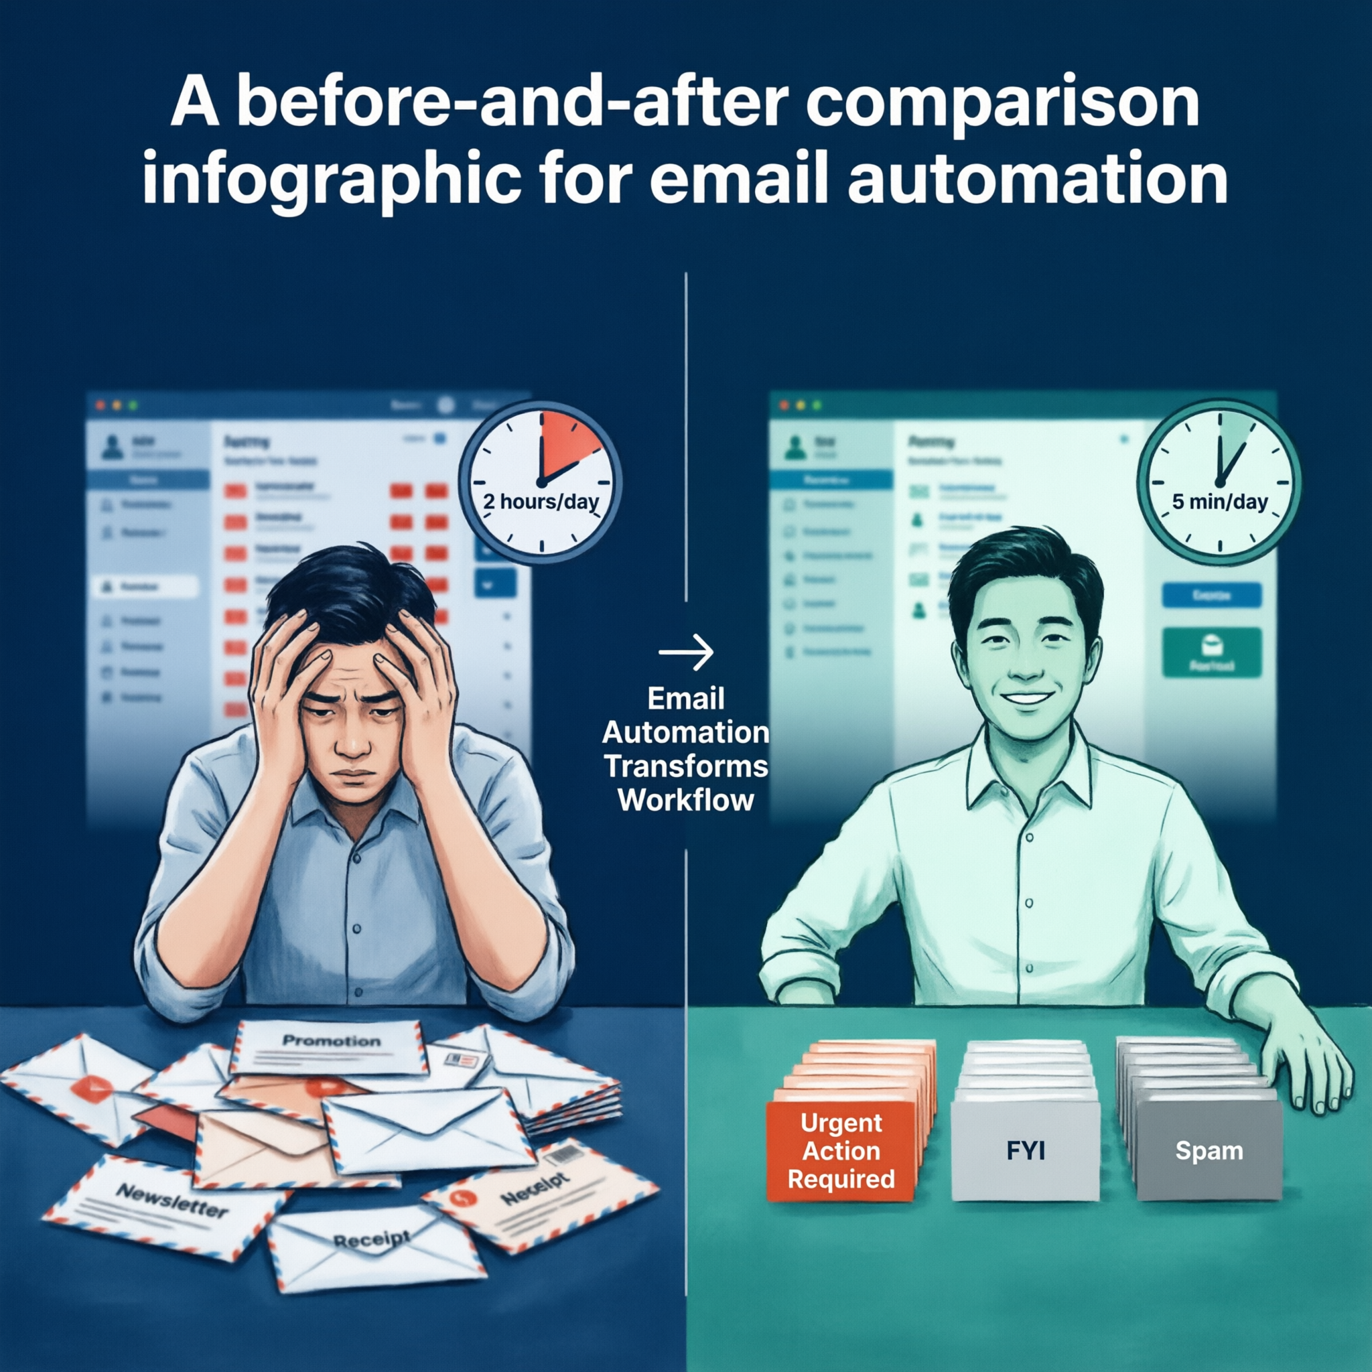
Use Case 1: Email Triage
BEFORE:
AFTER:
Manually read every email
Decide: respond, forward, archive, or delete
Spend 1-2 hours/day on inbox management
OpenClaw classifies every incoming email
Urgent emails get a Slack notification
FYI emails summarized in a daily digest
Draft responses prepared automatically
Time saved: ~5 hours/week · You'll build this in Lab 3
16 / 20
Notes:
Walk through the before/after. This is one of the most impactful automations because everyone deals with email. The key is the classification system — you define the categories that make sense for YOUR role.

Slide 17
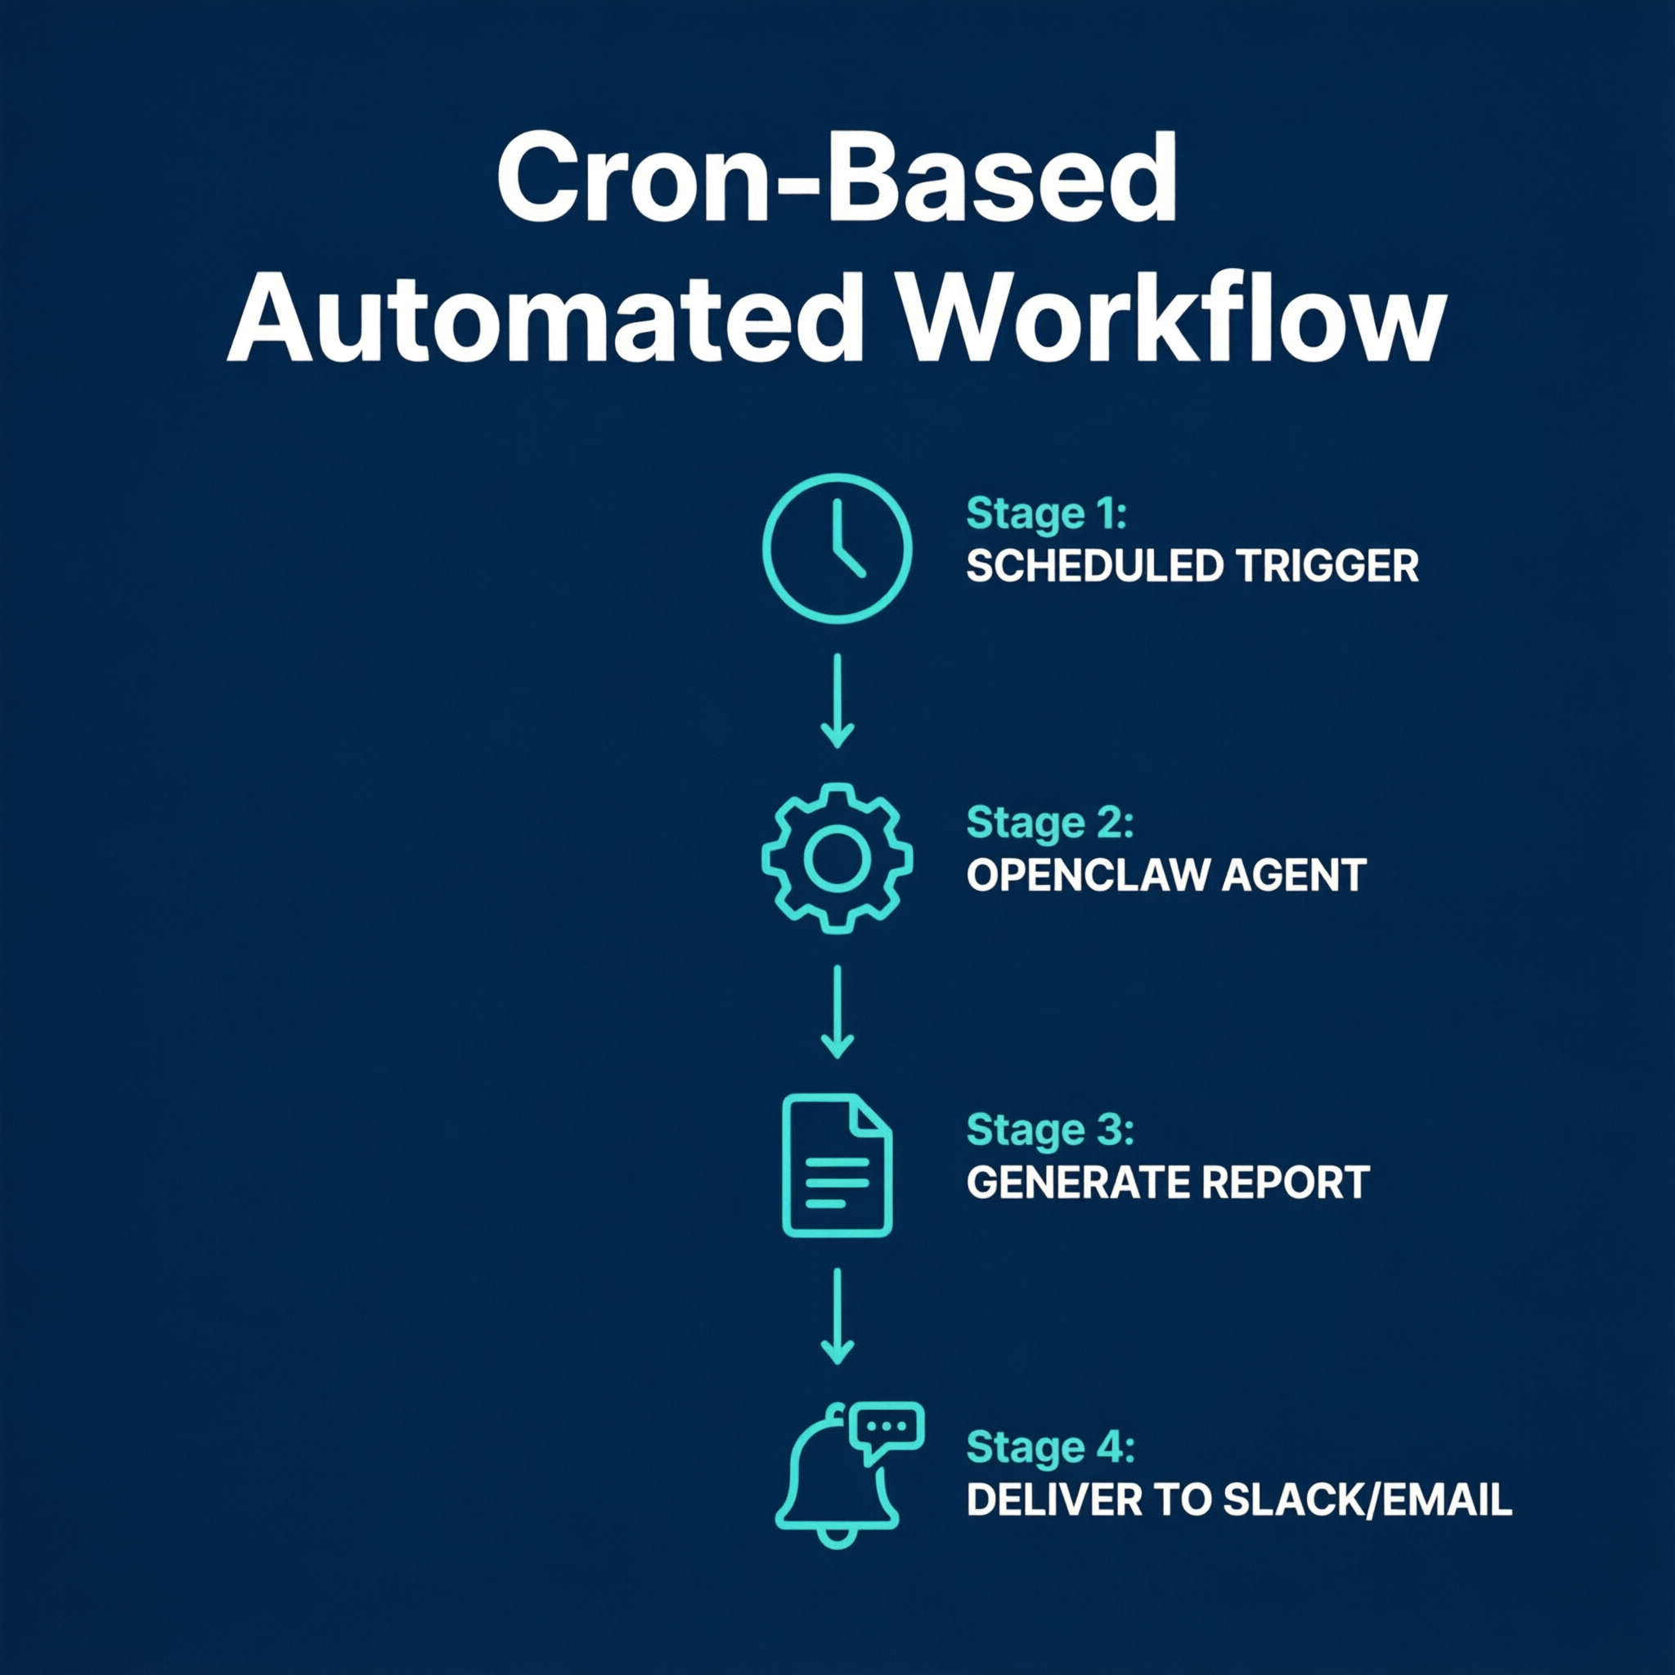
Use Case 2: Report Generator
📊 Data Source: CSV file, Google Sheet, or database
↓
🤖 OpenClaw reads data, identifies trends, writes summary
↓
📤 Output: Slack message, email, or generated document
↓
⏰ Schedule: Every morning at 9 AM via cron job
Time saved: 2 hrs/day · You'll build this in Lab 2
17 / 20
Notes:
This is the cron-based report generator. The data source can be anything — a CSV on your desktop, a Google Sheet, even a database query. OpenClaw reads it, analyzes it with AI, and sends a summary to your Slack.

Slide 18
Use Case 3: Meeting Scheduler
Incoming meeting request → OpenClaw checks your calendar
Finds available slots within your preferences
Sends suggested times back to the requester via Slack/email
Once confirmed, creates the calendar invite automatically
Sends reminder 15 min before with agenda and links
Eliminates: 30+ back-and-forth emails per week
18 / 20
Notes:
Meeting scheduling is one of the most time-consuming admin tasks. OpenClaw can check availability, propose times, and send invites — all automatically. This demo uses the calendar integration plus Slack for communication.

Slide 19
Use Case 4: Document Drafter
Trigger: Form submission, webhook, or Slack message
OpenClaw generates a first draft using your template
Output: Google Doc, Word file, or formatted Slack message
You review and edit — never start from a blank page
Draft in 60 seconds vs. 30 minutes from scratch
Examples: Meeting minutes, project updates, client proposals, status reports
19 / 20
Notes:
The document drafter is about never starting from a blank page. You describe the type of document, provide some context, and OpenClaw generates a structured first draft. You review and edit — saving 80-90% of the initial drafting time.

Slide 20
Tomorrow: Hands-On Day 🚀
6 hours of building. 4 labs. 1 capstone project.
Lab 1: Connect OpenClaw to Slack or Teams
Lab 2: Build a cron-based daily report
Lab 3: Create a custom email triage skill
Lab 4: Set up a webhook-driven document workflow
Capstone: Automate YOUR real work task
Bring your laptop, your API key, and one real task you want to automate!
20 / 20
Notes:
Wrap up Day 1. Remind everyone what to bring tomorrow: laptop with OpenClaw installed, API key, and one real task they want to automate. Answer any remaining questions. Share the feedback QR code.

