Slide 1

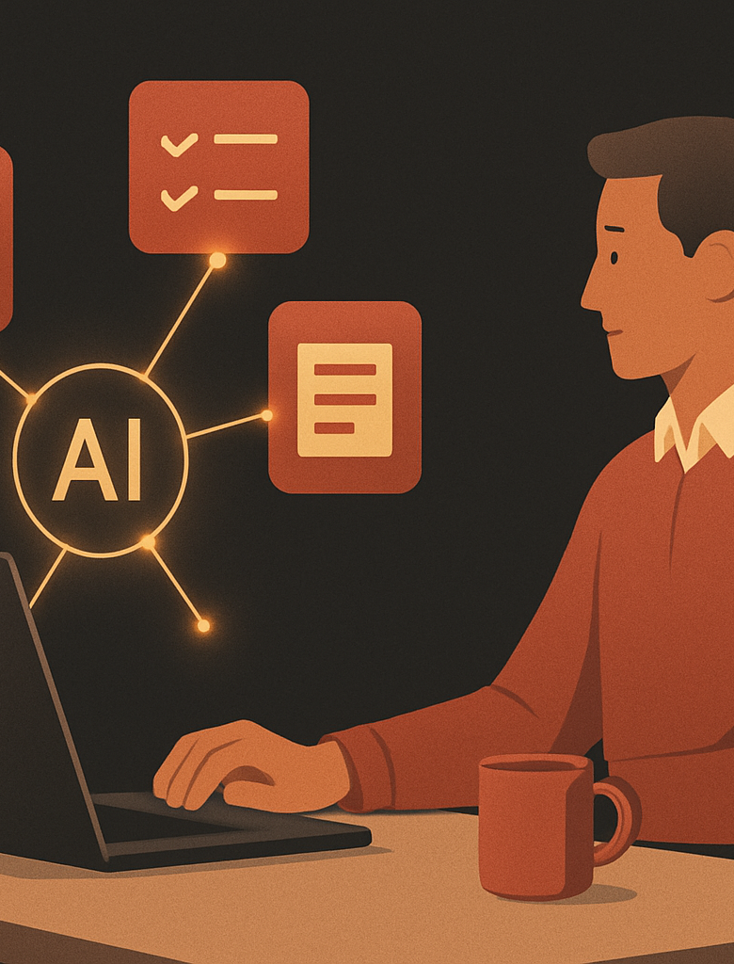

AI Automation Series. Session 1
Office Automation With Hermes
Learn the simple model behind AI tools for email, briefs, meetings, and daily tasks.
DAY 1. CONCEPTS AND THEORY
Theory
Hermes Agent
No coding
Approval first
AI Automation Series · © 2026 PakEdX
01 / 20

Slide 2
ORIENTATION
What You Will Understand Today
The goal
Use Hermes to remove repeated office work, not human judgement.
The four blocks
Channels, skills, cron, and webhooks design most workflows.
The safety rule
Hermes drafts and organises. You approve anything that leaves your name.
The build map
Tomorrow you turn these ideas into four working tools.
AI Automation Series · © 2026 PakEdX
02 / 20

Slide 3
01
WHY AUTOMATE
The Work Problem
AI Automation Series · © 2026 PakEdX
03 / 20

Slide 4
Office Work Has Repeat Patterns
Email takes attention
A busy inbox hides the few messages that need action.
Mornings start cold
People waste time finding what changed while they were away.
Meetings lose tasks
Decisions are made, but owners and dates often disappear.
Daily planning repeats
The same sources are checked again and again each morning.
Good automation handles the boring first draft, then waits for you.
AI Automation Series · © 2026 PakEdX
04 / 20

Slide 5
TOOL
Meet Hermes Agent
Open source
Hermes is from Nous Research and can run on your own machine or server.
Persistent memory
It can remember projects, preferences, and useful past work.
Reusable skills
It can save good procedures as plain text skills and reuse them.
Many channels
One assistant can talk through chat apps, email, and a web interface.
AI Automation Series · © 2026 PakEdX
05 / 20

Slide 6
02
MENTAL MODEL
Four Building Blocks
AI Automation Series · © 2026 PakEdX
06 / 20

Slide 7
MENTAL MODEL
Hermes Building Blocks
Channels
Skills
Cron
Webhooks
Doorways where people talk to Hermes.
Plain English tasks that tell Hermes what to do.
The clock that runs a skill on a schedule.
The doorbell that lets another app start work.
A channel starts the conversation. A skill does the job. Cron and webhooks start it at the right time.
AI Automation Series · © 2026 PakEdX
07 / 20

Slide 8
BLOCK 1
Channels Are Doorways
Web chat
Use it when you are at the laptop and want fast testing.
Email
Use it when the work starts inside your inbox.
Phone chat
Use it when you need the same assistant while moving.
The assistant is the same. Only the doorway changes.
AI Automation Series · © 2026 PakEdX
08 / 20

Slide 9
BLOCK 2
Skills Are Tasks
Plain English
Write instructions the way you would brief a new assistant.
Clear trigger
Say when the skill should run and what it should read.
Expected output
Name the format, tone, length, and review step.
A good skill says what to do and what not to do.
AI Automation Series · © 2026 PakEdX
09 / 20

Slide 10
BLOCK 3
Cron Is The Clock
Scheduled work
Run a skill daily, weekly, or at a fixed time.
Time zone matters
Set Pakistan Standard Time so 08:00 means your morning.
Test before trust
Fire the schedule in two minutes before using it daily.
Cron turns a chat tool into an assistant that works while you sleep.
AI Automation Series · © 2026 PakEdX
10 / 20

Slide 11
BLOCK 4
Webhooks Are The Doorbell
Outside trigger
Another app can start Hermes when something happens.
Simple example
A form submission can create a follow up task.
Use later
Most office workflows start with channels, skills, and cron.
Webhooks are the next step after you are comfortable with the first three blocks.
AI Automation Series · © 2026 PakEdX
11 / 20

Slide 12
03
SAFETY MODEL
Control And Trust
AI Automation Series · © 2026 PakEdX
12 / 20

Slide 13
Approval First Keeps Control
Drafts, not sends
Hermes prepares replies and summaries without acting alone.
Human review
You approve, edit, or reject each important output.
Clear never lines
Write rules like never send without my approval.
Start low risk
Begin with drafts, sorting, summaries, and checklists.
AI Automation Series · © 2026 PakEdX
13 / 20

Slide 14
Write Skills Like A Clear Brief
When it runs
Name the trigger, such as new email or weekday morning.
What it reads
List the sources, such as inbox, calendar, or pasted notes.
What it returns
Ask for a short list, draft reply, or table.
What it avoids
Tell it what it must not invent, delete, or send.
Clear instructions are the main skill for no code automation.
AI Automation Series · © 2026 PakEdX
14 / 20

Slide 15
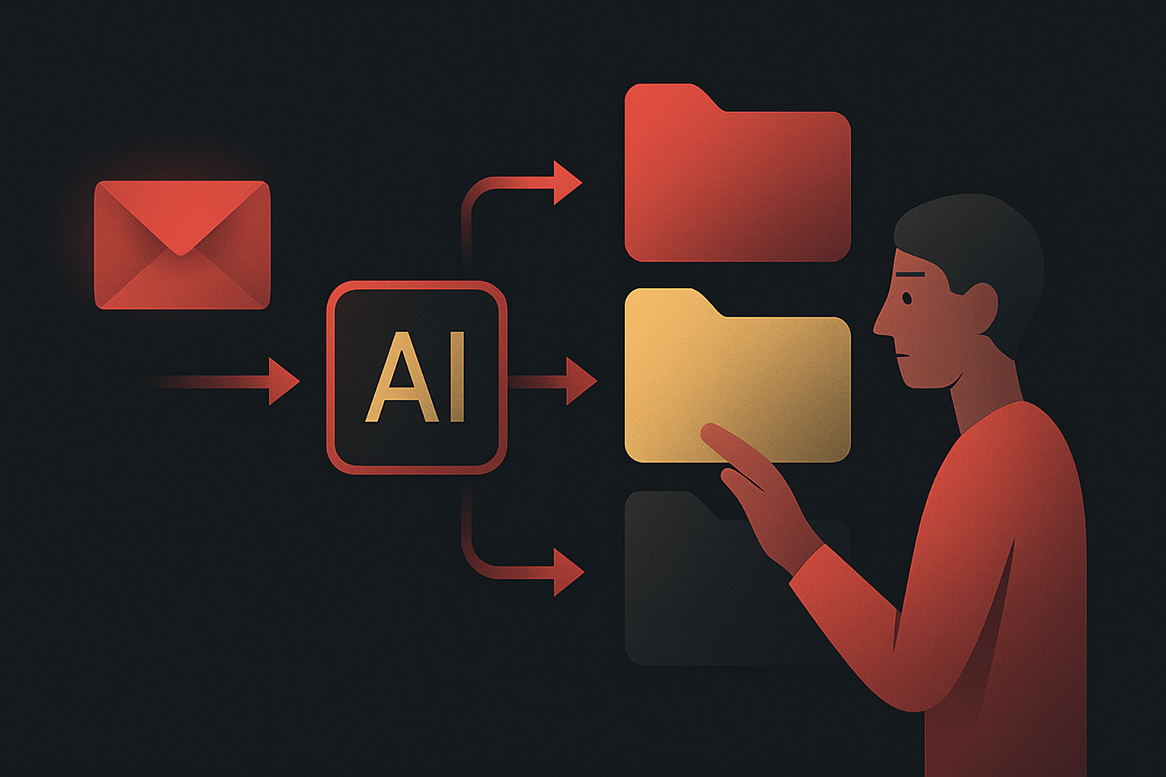
BUILD 1
Build Concept: Email Triage Agent
Sort
Group emails into Needs Reply, FYI, and Ignore.
Draft
Prepare short replies only for routine messages.
Protect
Show every draft for approval before anything is sent.
The agent prepares the work. The human keeps control.
AI Automation Series · © 2026 PakEdX
15 / 20

Slide 16
HOW IT WORKS
Email Triage Agent Flow
New Emails
Read And Sort
Draft Reply
Approve
Send Or File
Client mail, updates, newsletters, and spam arrive.
Hermes groups each message by action needed.
Routine replies are prepared in your voice.
You edit, reject, or approve each draft.
Only approved work leaves your inbox.
Safety rule: Hermes can draft. It must not send without approval.
AI Automation Series · © 2026 PakEdX
16 / 20

Slide 17
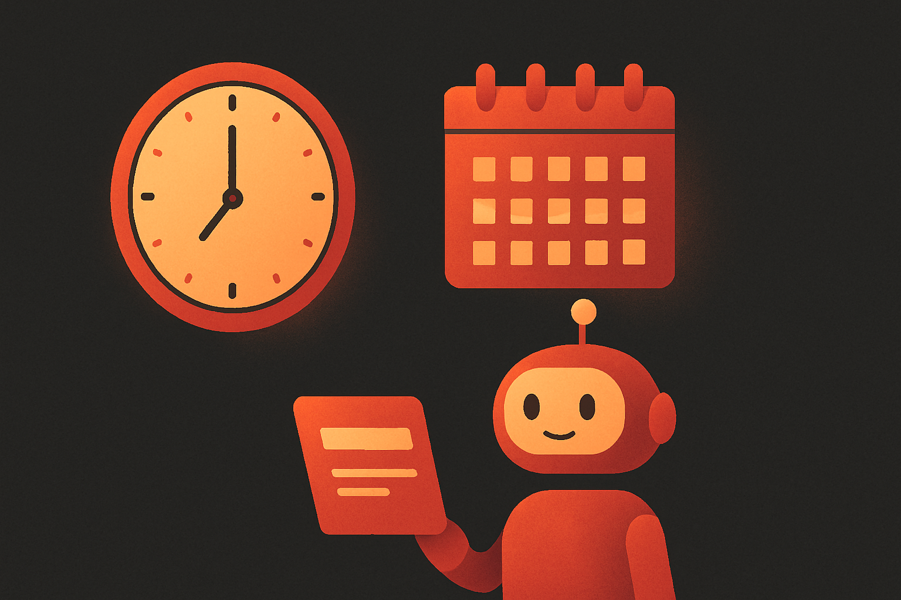
BUILD 2
Build Concept: Morning Brief Bot
Inbox
Summarise important new emails since yesterday.
Calendar
List today's meetings with clear times.
Top 3
Choose the three tasks that need focus today.
The agent prepares the work. The human keeps control.
AI Automation Series · © 2026 PakEdX
17 / 20

Slide 18
HOW IT WORKS
Morning Brief And Cron
Cron Schedule
Morning Brief
Delivery Channel
08:00
Runs on weekdays, even when you are not watching.
Reads inbox, calendar, and the focus rules you set.
Sends the short brief to web chat, email, or phone.
PKT
Always test a schedule two minutes from now, then set it back to 08:00 PKT.
AI Automation Series · © 2026 PakEdX
18 / 20

Slide 19
ROI VIEW
Before And After Time Saved
Before Hermes
With Hermes
Email sorting
45 min
15 min
Morning planning
30 min
5 min
Meeting actions
40 min
12 min
Daily task list
25 min
6 min
These four tools can save about 8 hours each week when used every workday.
AI Automation Series · © 2026 PakEdX
19 / 20

Slide 20
SESSION 1
Tomorrow, Build The Tools
Email Triage
Sort messages and prepare safe reply drafts.
Morning Brief
Run a daily brief on a cron schedule.
My Day Tracker
Connect email, meetings, and calendar into one list.
AI Automation Series · © 2026 PakEdX
20 / 20

